Slide 1


HR Attrition Analysis
Capstone Project

Slide 2

Content
Objective
Executive Summary and key findings
Data Summary and Pre-processing
Exploratory Data Analysis
Feature Engineering & Data Preparation
Hypothesis Testing
Predictive Modelling and Evaluation
Conclusion and Recommendation

Slide 3
Objective
Attrition in human resources refers to the gradual loss of employees over time. A major problem in high employee attrition is its cost to an organization. The client company wants us to use their employee data and come with the insights and predictions that helps them to understand factors affecting employee attrition and plan their future workforce.

Slide 4
Executive Summary and key findings
HR Attrition Analysis

Slide 5
Executive Summary and key findings
Three-year data: Analysis is performed on three years data starting Jan 2011 to Dec 2013 for the Plumbing & Drain Service company (PDS).
No Significant trend/seasonality visible- Overall business reasonably flat, total revenue $ 2.24 million from 1058 unique customers who make 5284 service calls in three years.
Reasonable coverage throughout the United States, presence in 28 states, and operates 47 branches
On a typical year – 63% of service calls are received from returning base and 37% new.
> Almost 70% of new customers a year are acquired as diligent or Savvy base.

Slide 6
Executive Summary and key findings
Day of week and Hour of day analysis suggests – Mondays make more business compared to other days of week (on avg. 37% more service call on Mondays)
> Morning from 7AM till late afternoon sees maximum calls peak around 11AM (82% of total calls)
> 57 % of total service calls across branches/states is by Customer type 1
> Almost 42% of total calls/revenue are with Job code 2,1 and 0 in respective order.
Analysis able to explains about 99% of the variation in data accurately to predict customer Churn.

Slide 7
Data Summary and Pre-processing
HR Attrition Analysis

Slide 8
Data Summary and Pre-processing
We have used Case_study_1_Hr_attriton.xlsx ,sheet=1 for the analysis.
Total 2940 records/observations
31 variables of mixed datatypes
10 categorical variables and 21 continuous variables

Slide 9
Data Summary and Pre-processing
Missing Value Treatment: 49 missing values in Work Life Balance feature found. Treated by Simple Imputing with mean of the feature.
Categorical Features: 10 features found categorical and are converted into levels by Lable Encoding.
Outliar Treatment: Took threshold value of z_score is 3 as outliers. Dropped records containing outliers and loaded the them into new data frame.

Slide 10
Data Summary and Preparation
Dropped features ‘Employee_ID’, ‘18Yrs’, ‘Standard hours’ as they provide no insight over the Target Variable.
Rounded the values imputed in Work Life Balance feature to the nearest integer.
Data has been Up-sampled and loaded into new data frame.

Slide 11

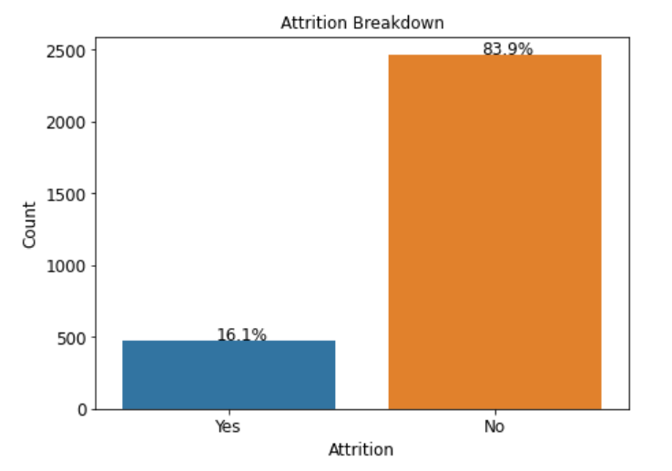
Target/Churn Definition
Our churn variable is the feature ‘Attrition’ on which the model will built on. Attrition is a categorical feature contains data of ‘Yes’ and ‘No ’ encoded into 1 and 0 respectively.
The bar graph shows that target variable is predominantly made of ‘No’.
16.12% Attrition happened.
Data is imbalanced

Slide 12
Variable | Meaning
Last_promotion_gsp | Years when last promotion Gsp Received
Years@Current Mangers | Number of years working under current Maneger
Education | Lastest Education pursued
EducationField | Fieldof education
Employee_ID | Employee Id in the organisation
Env_Satisfaction | Environment Satisfaction of the employee 1- Low,2-Medium,3-High,4-Very High
Gender | Gender of the Employee(Male /Female)
HourlyRate | Amount that the employee has been paid for an hour
Job_Involvement | Involvement of the employee in the job 1- Low,2-Medium,3-High,4-Very High
JobLevel | Level of Job Role in the Company 1:5 -> Lower level : Higher Level
JobRole | The Role of the employee in a perticular department
Job satisfac | Job Satisfaction of the employee 1- Low,2-Medium,3-High,4-Very High
Marital Status | Marital Status of the Employee(Married/Single/Divorced)
Monthly Income | Monthly Salary of the employee
Company Changed | No . Of companies employee has changed
18Yrs | Is the age of the employee 18Yrs above?(Y/N) [All employees are above 18]
Over Time | Whether the employee has done over time?(Yes/No)
PercentSalaryHike | Percentage of Salary Hiked of Employee
Performance Rating | Rating the Performance of the employee :1- Low,2-Medium,3-High,4-Very High
Relationship Satisfaction | Relationship Satisfaction of the employee 1- Low,2-Medium,3-High,4-Very High
Standard Hours | Standard hours is the number of hours of production time that should have been used during an accounting period
Stock Option Level | stock option Level is a type of equity compensation granted by company to their employees(0,1,2,3)
Total Working Years | Number of Years the employee has been working from
Training time spent | Number of months they have received training from the Company
Work LifeBalance | Work life Balance : 1-Bad,2-Good,3-Better,4-Best
Years @company | Number of Years of the employee assosiated with this Company
Years@Current role | Number of Years the employee has been working in the current role in this company
BusinessTravel | Travel History of the employee related to business: (Non-Travel, Travel-Frequently, Travel rarely)
Dept | The Department of the employee that is currently working in the company ( Human Resources , Research & Development ,Sales
Travel_distance | The travel Distance from Work place to Home of an employee
Attrition | Attrition of the employee(Yes/No)

Slide 13
Exploratory Data Analysis
HR Attrition Analysis

Slide 14
Univariate Analysis Categorical Variables
HR Attrition Analysis

Slide 15
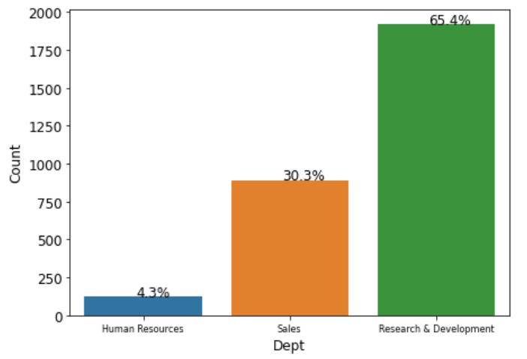
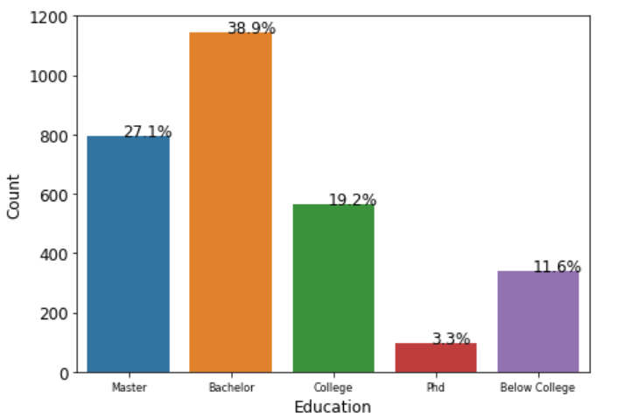
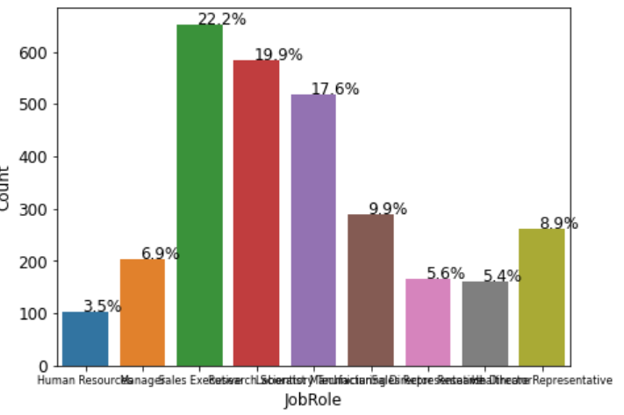
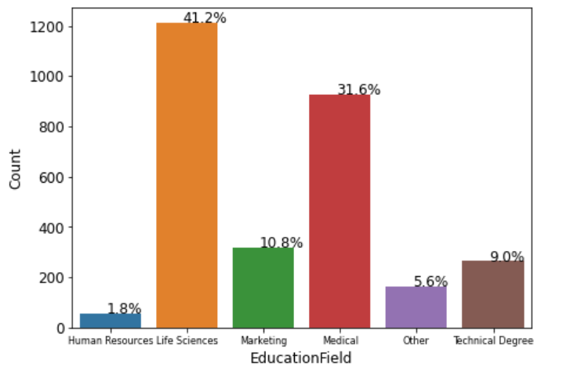

Slide 16
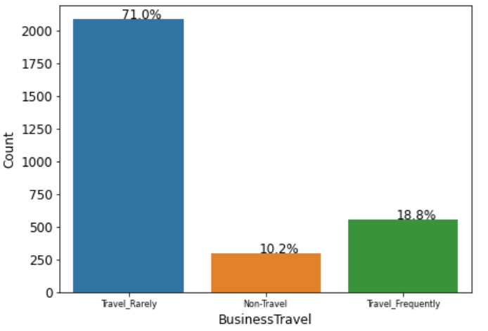
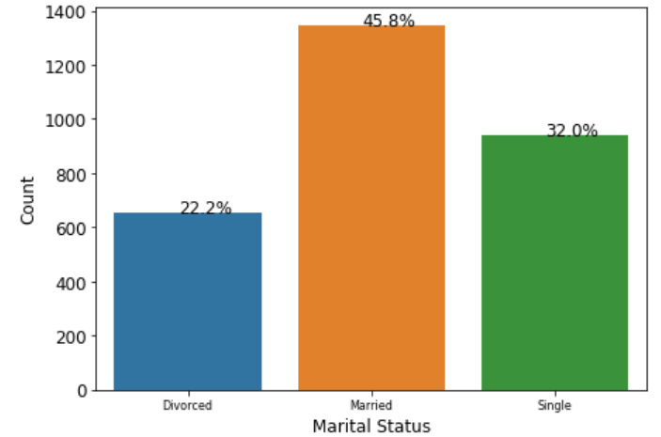
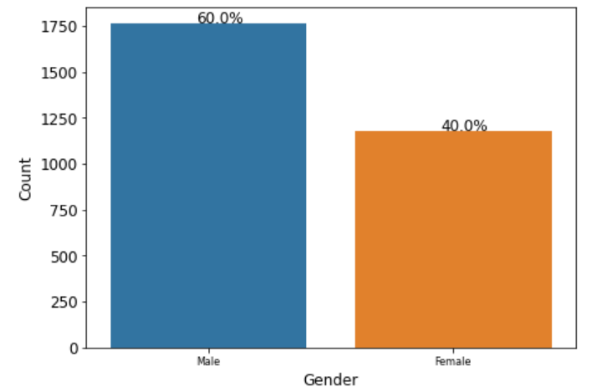
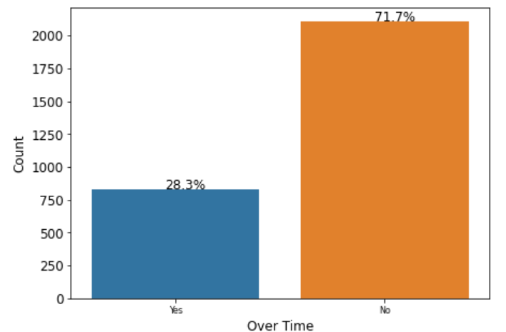

Slide 17
Bivariate Analysis
HR Attrition Analysis

Slide 18



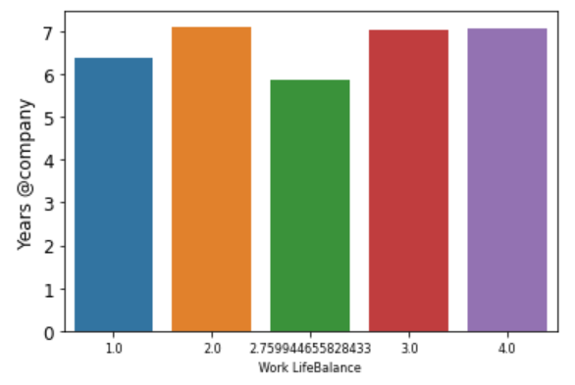
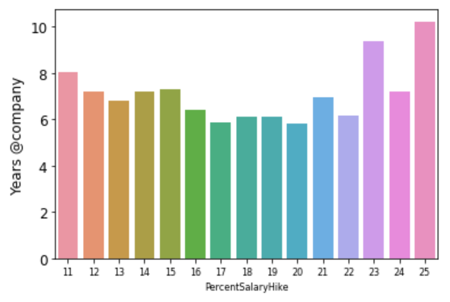
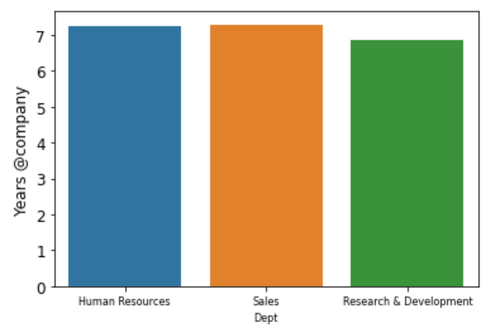
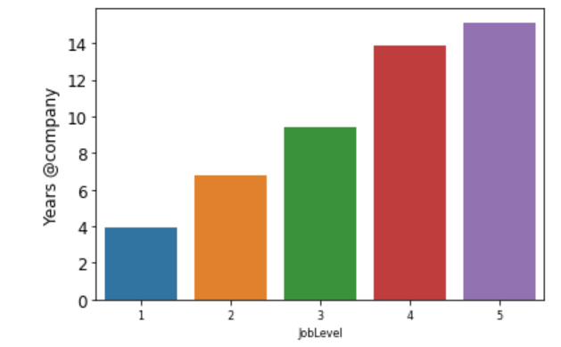


Years at Company

Slide 19
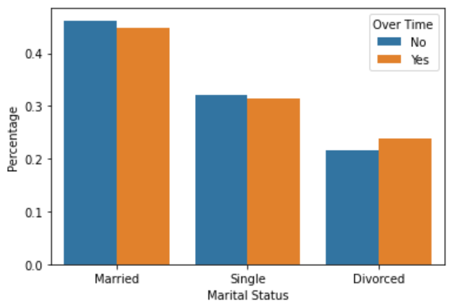
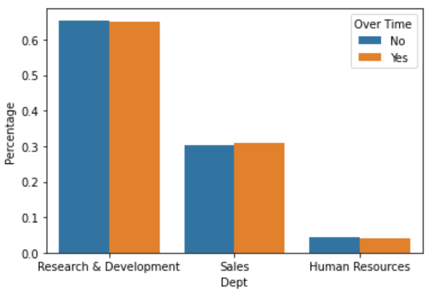
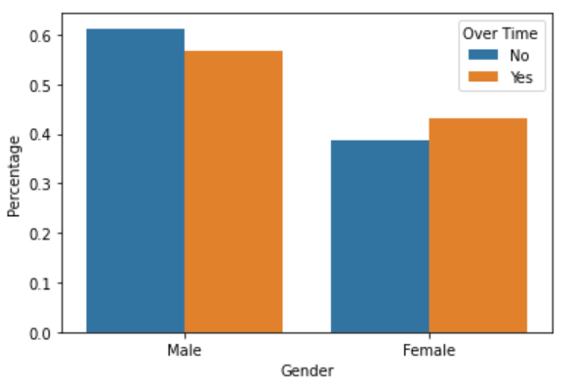
Over Time Distribution

Slide 20
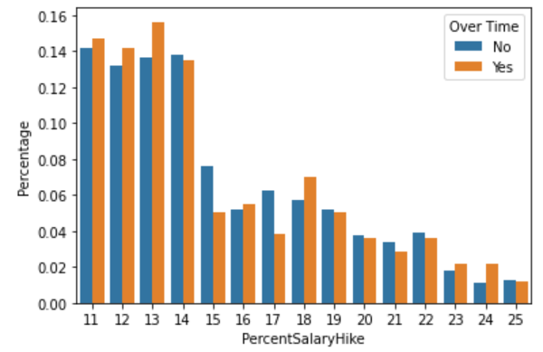
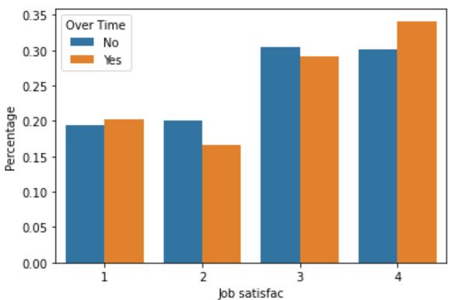
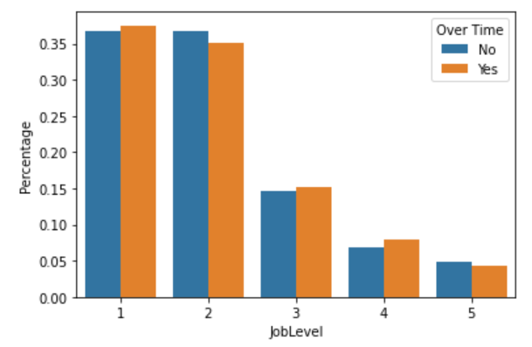
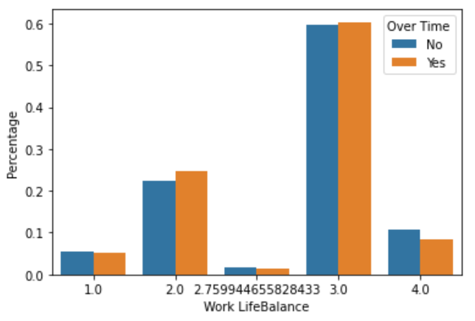

Slide 21
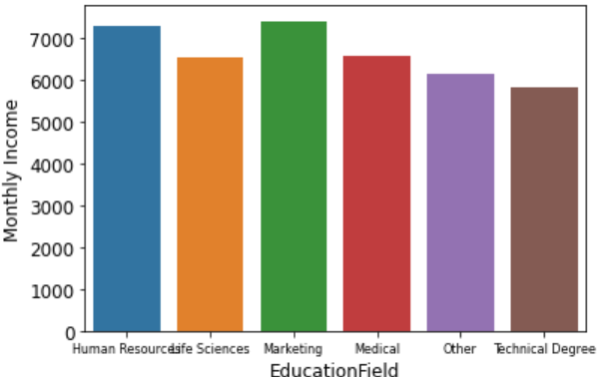
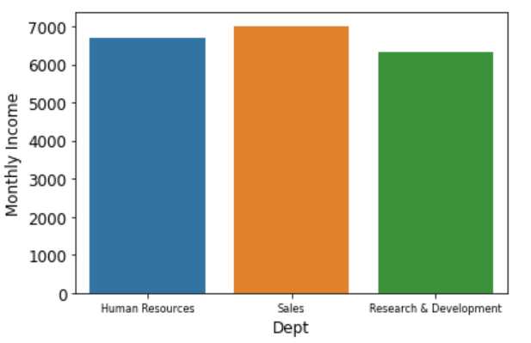
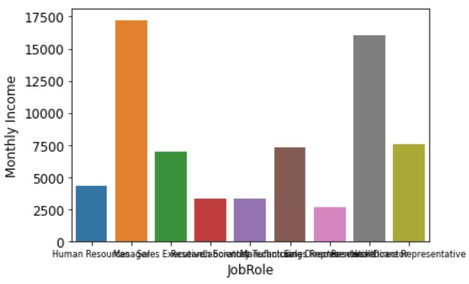
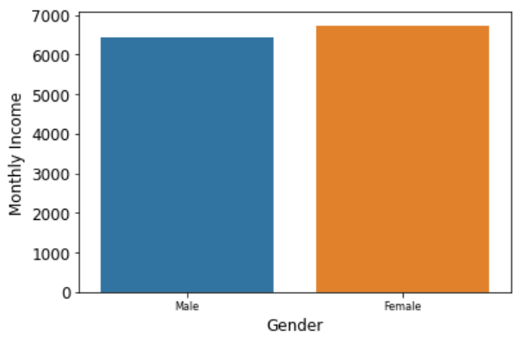
Monthly Income Distribution

Slide 22
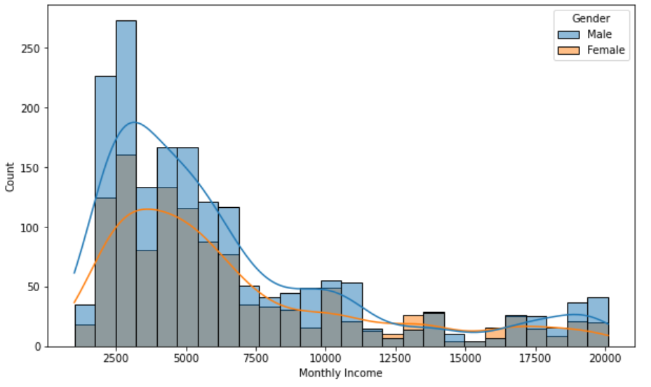
Distribution of Monthly Income vs Gender

Slide 23
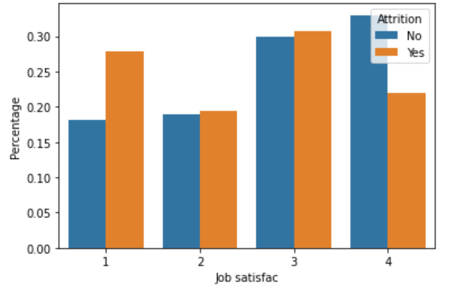
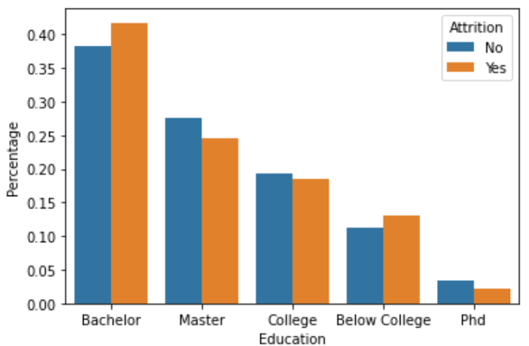
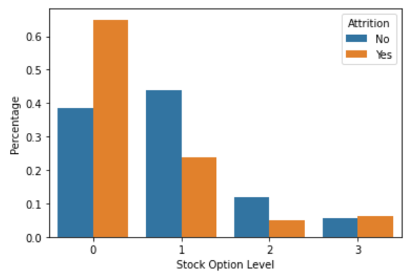
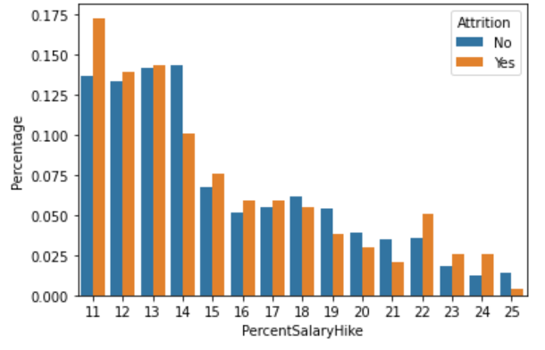
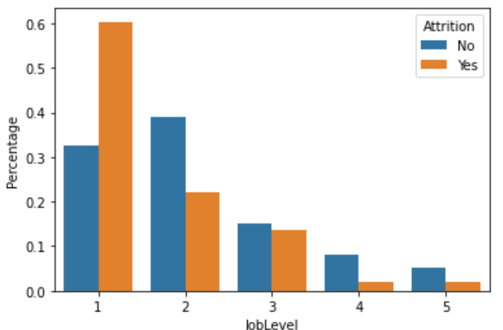
Attrition Analysis

Slide 24
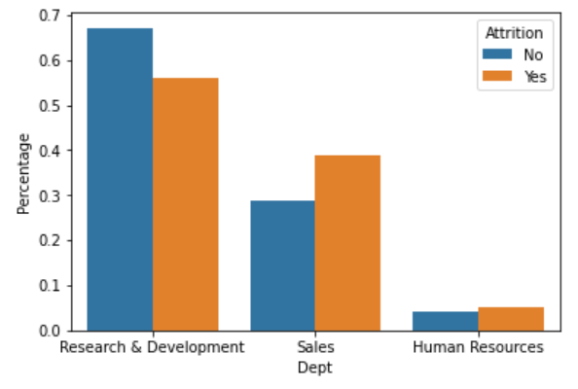
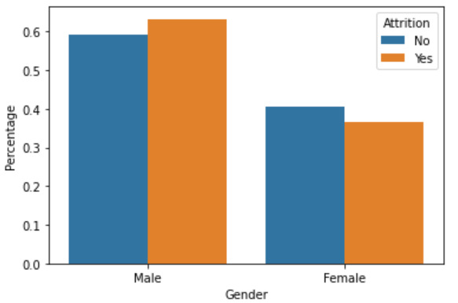
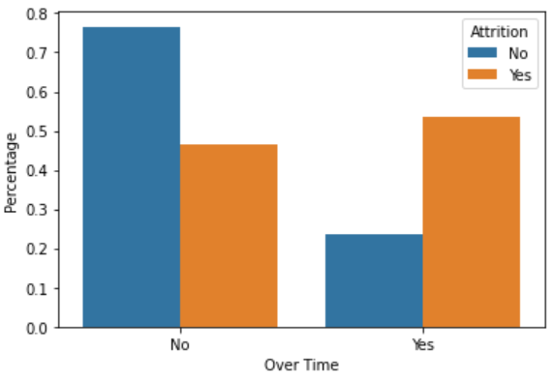
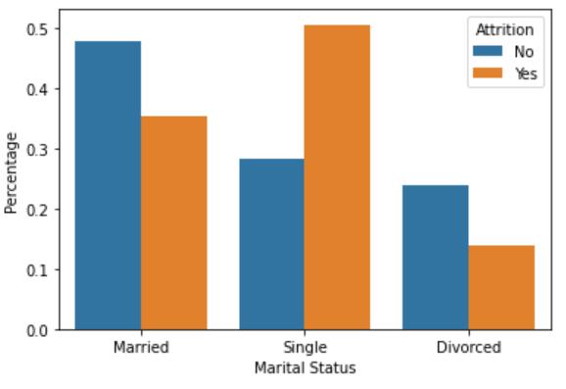
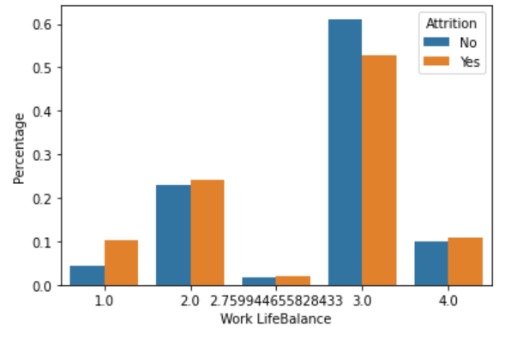

Slide 25
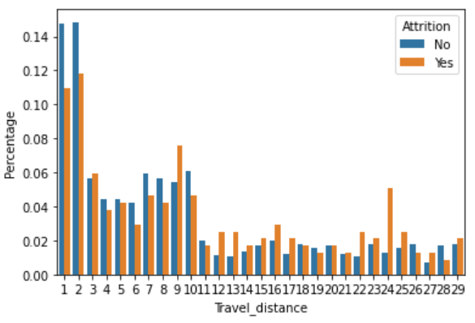
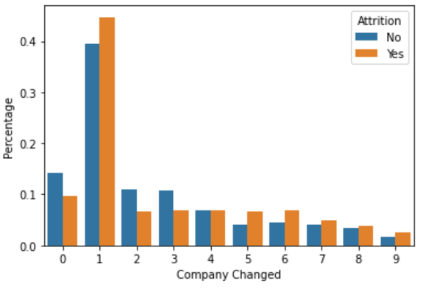
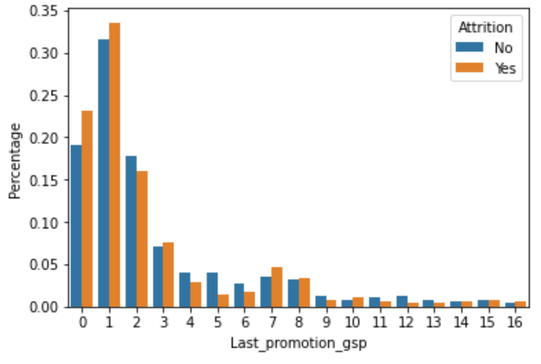
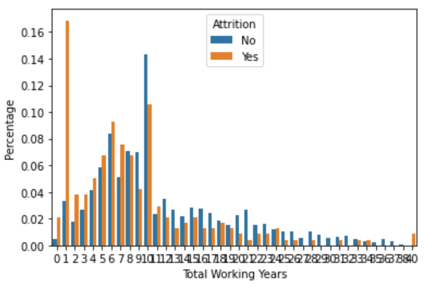
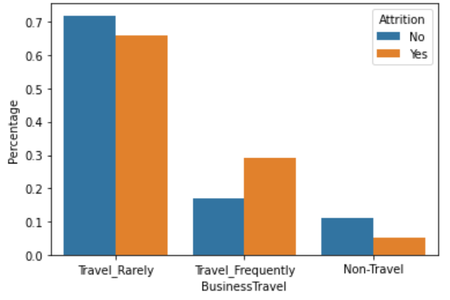

Slide 26
Multi-vairate Analysis
HR Attrition Analysis

Slide 27
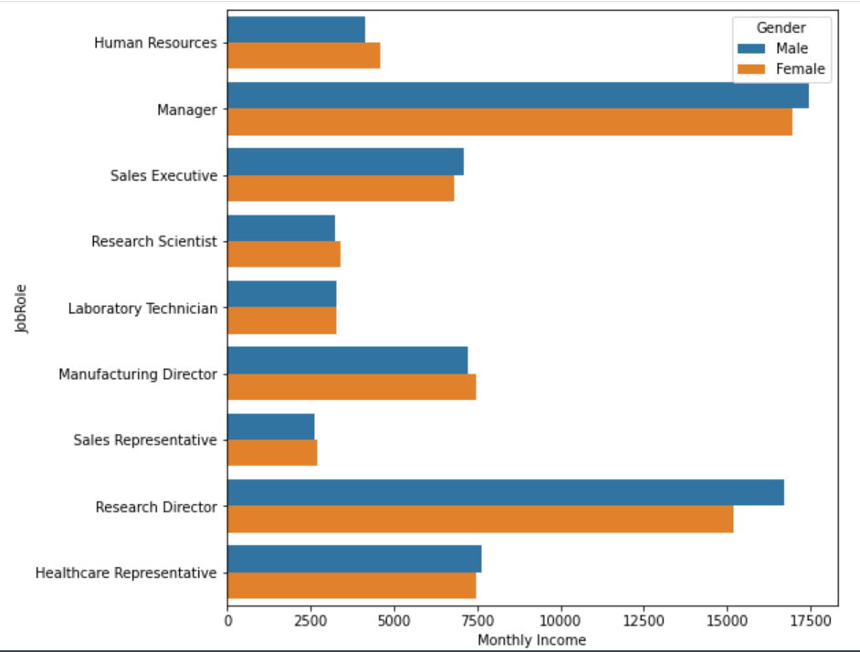
Exploratory data analysis (EDA): geographical presence
Managers and Research Directors have higher income compared to other Job Roles
Females are less paid in Higher income Job Roles
Also Females are paid lesser for the role of Sales Executive

Slide 28
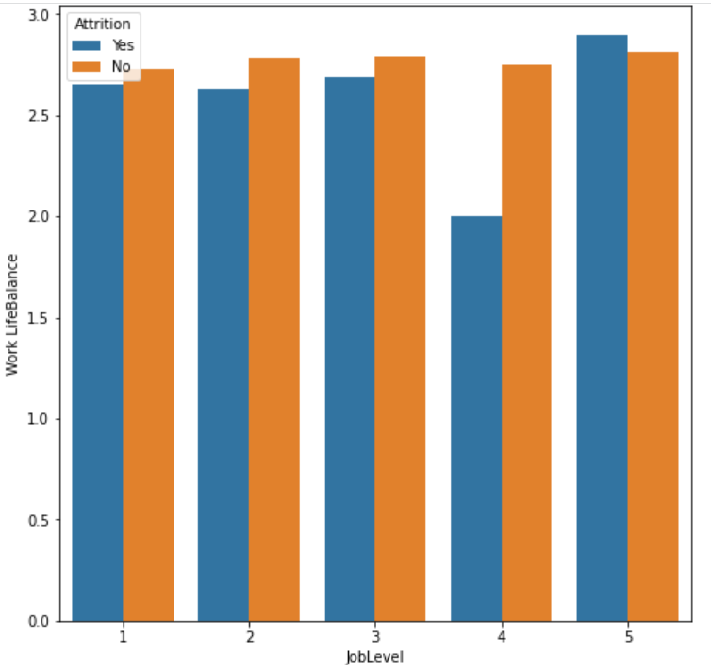
Job Level and Work Life Balance
Irrespective of Job Level, employees who have lesser Work Life Balance tend to leave.
However the above criteria does not satisfy the highest level employees pertaining other reasons

Slide 29
Feature Engineering & Data Preparation
HR Attrition Analysis

Slide 30
Feature Engineering
Multi Collinearity
Remove features whose correlation value is more than 0.8 because those features lead to multi collinearity and these can lead to high variance in the model. So the features are-
Total Working Years: 0.78(approx.'0.80) with Job level and 0.77(approx.'0.80) with Monthly Income
Job Level: 0.95 with Monthly Income and 0.78(~0.80) with Total Working Years
All other variables seems to have correlation less than 0.80

Slide 31
Feature Engineering
Derived Feature:
Environment Satisfaction, Job Involvement, Job satisfaction, Relationship Satisfaction were combined into Single Column named Combined Satisfaction.
Up Sampling:
The data has imbalanced target variable with higher percentage of ‘No’. Resample() from sci-kit learn is used to make equal number of ‘Yes’ and ‘No’

Slide 32
Data Preperation
The data is mutated into three data sets:
data: The data with no feature engineering done on it.
data_Feature_Engineered: The data with feature engineering done.
data_up: Data after up-sampling

Slide 33
Data Preperation
Train and Test Split: All the three mutations of data are divided into Train and Test data sets in the ratio of 80:20.
Performed K-Fold Cross Validation (K=5) with scoring parameter as accuracy to compare with our original scores.

Slide 34
Hypothesis Testing
HR Attrition Analysis

Slide 35
Summary of hypothesis testing statements
No. | Null Hypothesis statements | Accept/Reject
1 | None of the derived features contribute to predict customer churn | Reject
2 | As average number of hours to complete the job increases, probability of customer churn increases | Accept
3 | Average delay in days between service calls i.e. Avg. Latency has direct influence on customer churn | Accept
4 | More the number of distinct jobs used by customer, lesser is the probability of customer churn | Reject
5 | More the number of service calls made by customer, lesser the probability of customer churn | Reject
6 | As days since last call increases, probability of customer churn increases | Accept
7 | More the delay to pick up scheduled service calls, higher the probability of customer churn | Reject
8 | Higher the total revenue from customer, lower the probability of customer churn | Reject
9 | Service call day of a week does influence customer churn | Reject
10 | If customer uses service in consecutive years, then there is less chance that the customer churns | Accept

Slide 36
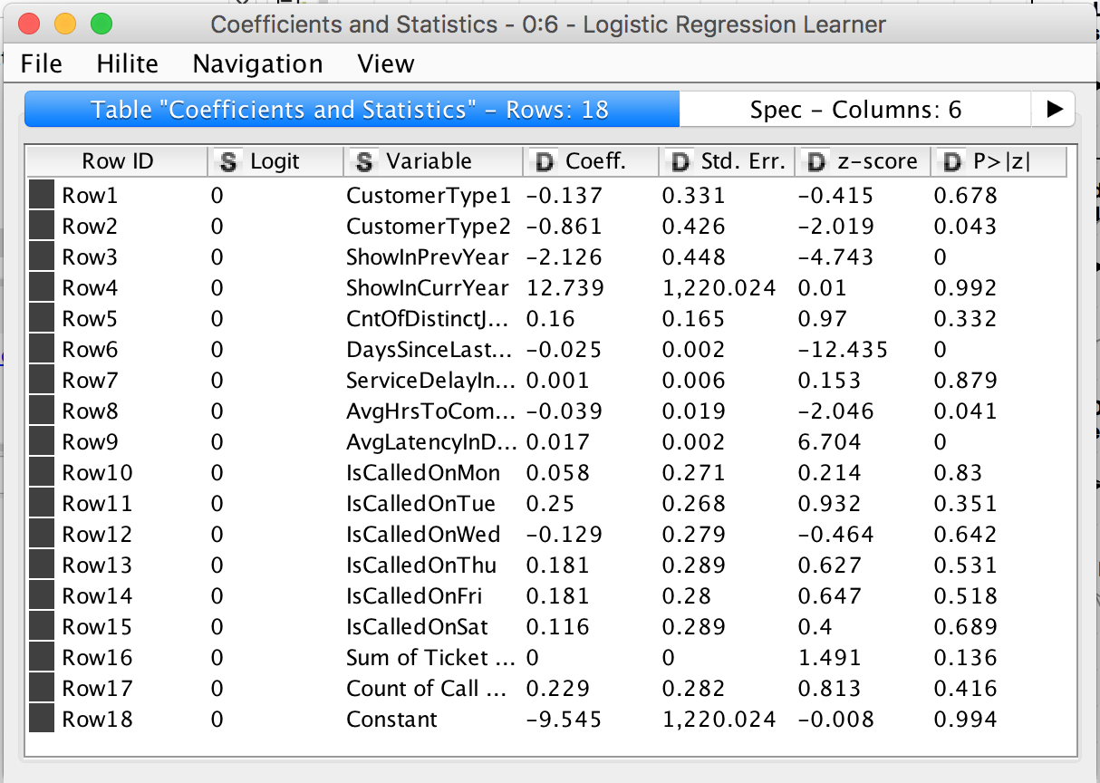

Slide 37
Predictive Modelling and Evaluation
HR Attrition Analysis

Slide 38
Xg Boost
We built Full Xg Boost model using capstone_csv.csv dataset.
Xg Boost is an implementation of gradient boosted decision trees designed for speed and performance.
Why Xg Boost?
Handles outliers by essentially binning them.
It has methods for balancing error in class population unbalanced data sets.
It is also indifferent to non-linear features.
it is very easy to measure the relative importance of each feature on the prediction.

Slide 39
In addition to Xg Boost, we will discuss about its Random Forest and Logistic Regression. Limitation of Logistic Regression: - The major limitation of Logistic Regression is the assumption of linearity between the dependent variable and the independent variables. - Highly sensitive to outliers and skewness.

Slide 40
Run Xg Boost model on Train and Test data

Slide 41
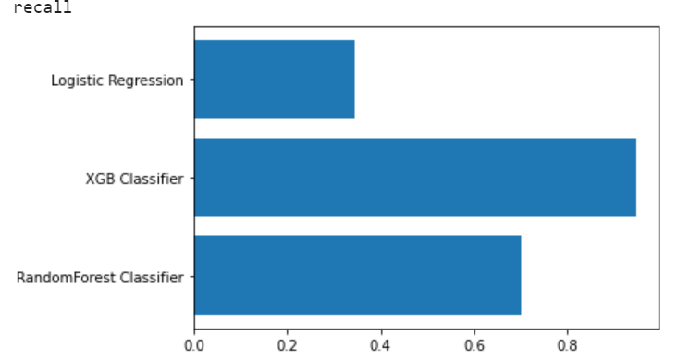
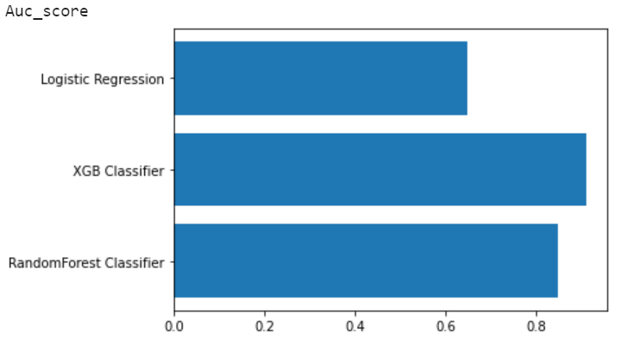
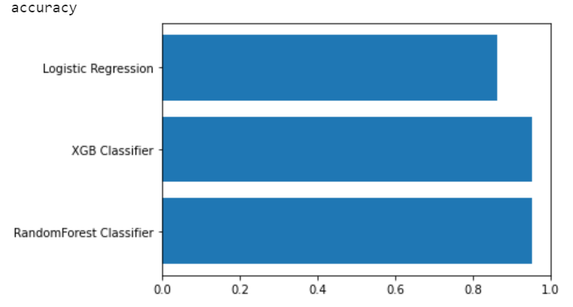
Modelling on Non feature engineered data set
Xgboost has higher recall, accuracy and Auc_score
Confusion Matrix | Actual-Yes | Actual-No
Predicted -Yes | 72(TP) | 4(FP)
Predicted- No | 15(FN) | 497 (TN)

Slide 42
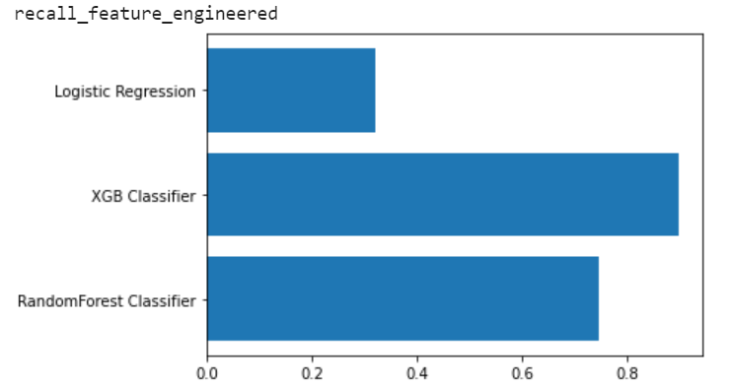
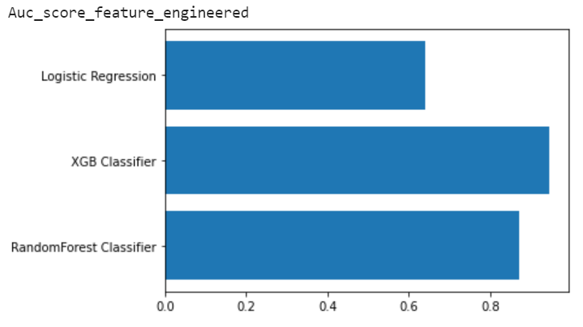
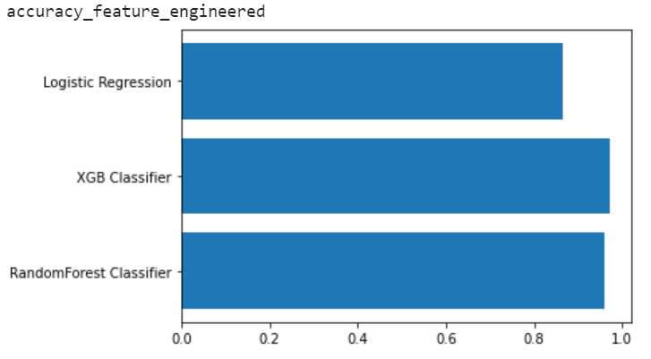
Modelling on feature engineered data set
Xg Boost has emerged as the final winning model with the highest Accuracy 97.1% and Recall 90.8% and AUC_score: 94.5% .
Confusion Matrix | Actual-Yes | Actual-No
Predicted -Yes | 79(TP) | 9(FP)
Predicted- No | 8(FN) | 492 (TN)

Slide 43
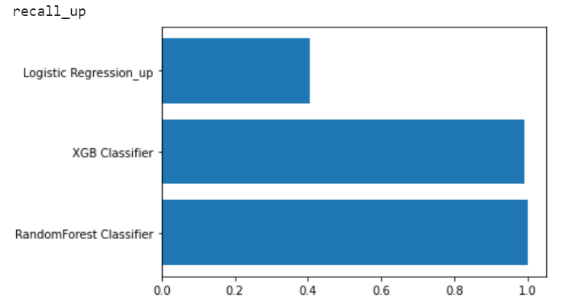


Modelling on up sampled data set
Random Forest has higher recall, accuracy and Auc_score
The metrics of Random forest and XgBoost are nearly 100% . This may either be an indication of Overfitting
Confusion Matrix | Actual-Yes | Actual-No
Predicted -Yes | 490(TP) | 0(FP)
Predicted- No | 4(FN) | 493(TN)

Slide 44

Feature Importance of Xg Boost Model on feature engineered data set
Based on the chart, we can con conclude that Stock Option Level and Over Time plays an important role in deciding attrition of an employee.
On the other hand Education, Performance Rating and Training time spent not tends to contribute.

Slide 45
Conclusion and Recommendations
HR Attrition Analysis

Slide 46
Conclusions
Organization’s attrition rate is 16.3% which is higher than industrial average attrition(10%)
On noticing the patterns, top factor for employee attrition in this organization seems to be monetary, as ‘Over Time’ and ‘Stock Option Level’ are the factors mostly driving attrition.
The next important factor seems to psychological features be:
Relationship Satisfaction with fellow workers, where current manager and job role could be the main contributing reasons for attrition.
Job Involvement is a critical satisfaction factor, employees who are more involved are less likely to leave the organization.

Slide 47
Conclusions
Employees who has done only Bachelors as Education, has Job Level = 1 and has Total Working Years =< 2 have higher chances of leaving the organization.
Pursuing longer years in the company, employees tend to promoted to higher level and have lesser attrition rate.
Sales Department employees has higher attrition rate which should be taken care of because it has direct impact on customer loss and customer relationships.
Work Life Balance has little to less impact on attrition in this organization. Surprising!!

Slide 48
Recommendations
To retain the employees HR should focus on the above conclusions and understand from the employee viewpoint.
Provide competitive benefits and Perks.
Organization should keep employees constantly involved and motivated. Especially Sales Department.
Keep employees engaged with other fellow employees.
The model needs to be tuned from time to time as when new data set is received.

Slide 49
Future Enhancements to the Model
The feature Performance Rating has been restricted to scores of 3 and 4 only. More insights could be generated if the full spectrum of performance ratings are included.
With the help of H.R team, A new feature ‘EduField_Job’ is created which defines whether Job Role is related to Education Field, with the labels ‘0’ = not related, ‘1’ = related, ‘2’ = somewhat related. This might give us an understanding of attrition in different perspective.
Feeding with more data would strengthen the model.
Performance over Validation data can give us more insights on achieved scores.

Slide 50
Thank You

